Slide 1
Aqua Map
Forecasting Flood Extents
M.Roopanya,21761A0539
K.Aswini,21761A0531
R.Syamala,21761A0548
J.Pujitha,21761A0521
M. Jogendra Kumar,21761A0540
B.Venkat,21761A0507
under the guidance of
N. Srinivasa Rao,
Sr. Assistant Professor

Slide 2
Table of content
Title
Problem Statement
Introduction
Objectives
Methodology architecture
Technology stack
Conclusion

Slide 3
Problem Statement
Projection of the extent of inundation corresponding to the forecasts of flood levels in a river.
Disaster Management

Slide 4
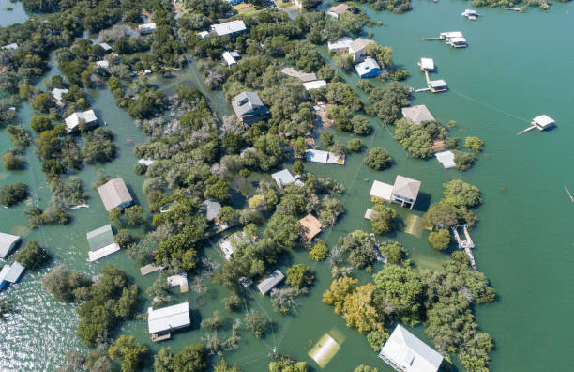
What is a flood and how does it occurs?
A flood is an overflow of water beyond the normal limits of a watercourse.
The most common cause of riverine flooding and flash flooding is heavy rainfall.
This can happen when it escapes from a natural watercourse, such as a lake, river or creek.
It can also happen when water is released from a reservoir, canal or dam.

Slide 5
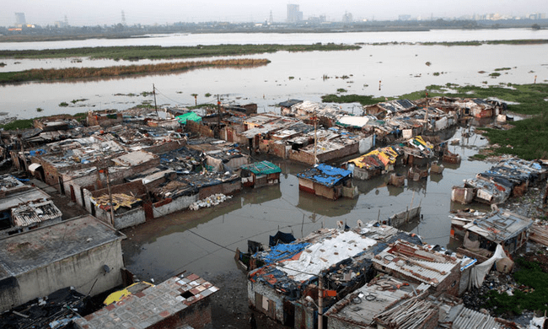
Affects of floods
Over the last century, floods have become the most common and natural disaster on the planet.
Flooding affects 21million people and costs over $96 billion damage worldwide every year.
South Asia is the one of the most affecting area, among all.

Slide 6
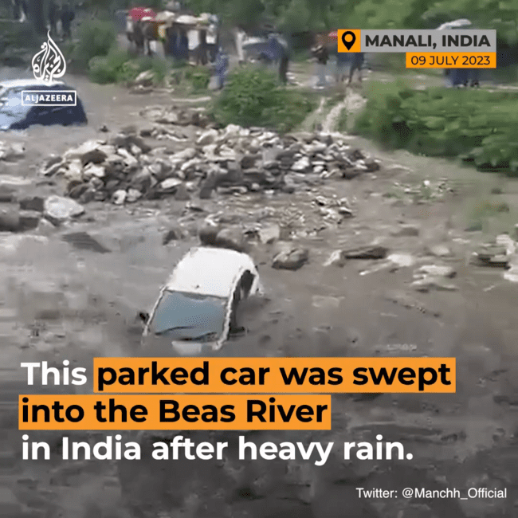
Many areas currently lack effective early warning systems and alerts, due to presence of no early data available.
20 percent of flood fatalities occur in India.

Slide 7
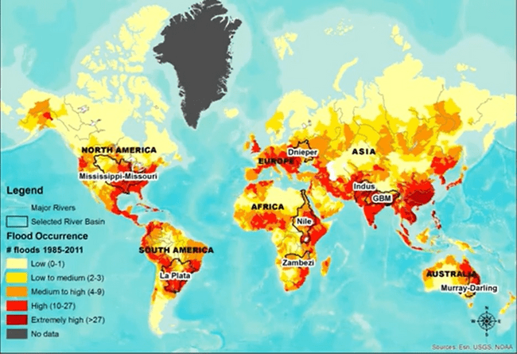
Some of the places and countries, where heavy floods were noticed according to the past history.
flooding is a serious threat – it's Australia's second-most deadly natural disaster.
The danger is often underestimated with devasting consequence

Slide 8
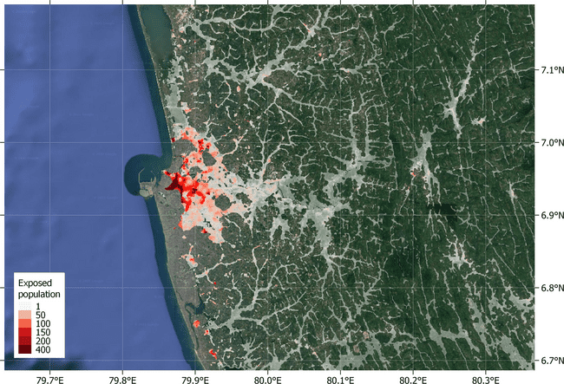
Sadly, most flood injuries and fatalities are preventable.
All these can be can be reduced by knowing the information earlier.
So that , the government officials can know the information better and can react fast.

Slide 9
Objectives
High Accuracy Mapping
Real-time Prediction
High Spatial Resolution
Automation
Scalability

Slide 10
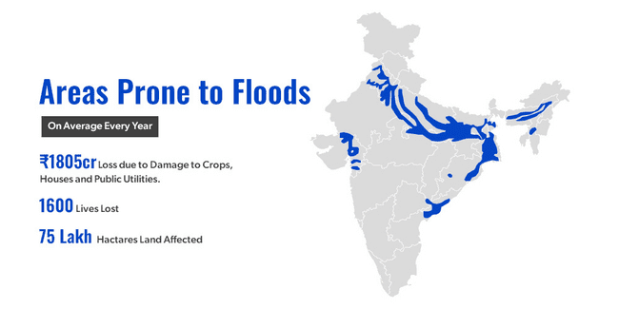
Existing methodologies
There are some methods implemented by the governments .
some of them are
. Hydrodynamic Models (2D Hydraulic Models)
. Remote Sensing and Satellite Imagery
. Rainfall-Runoff Models
.Ensemble Forecasting

Slide 11
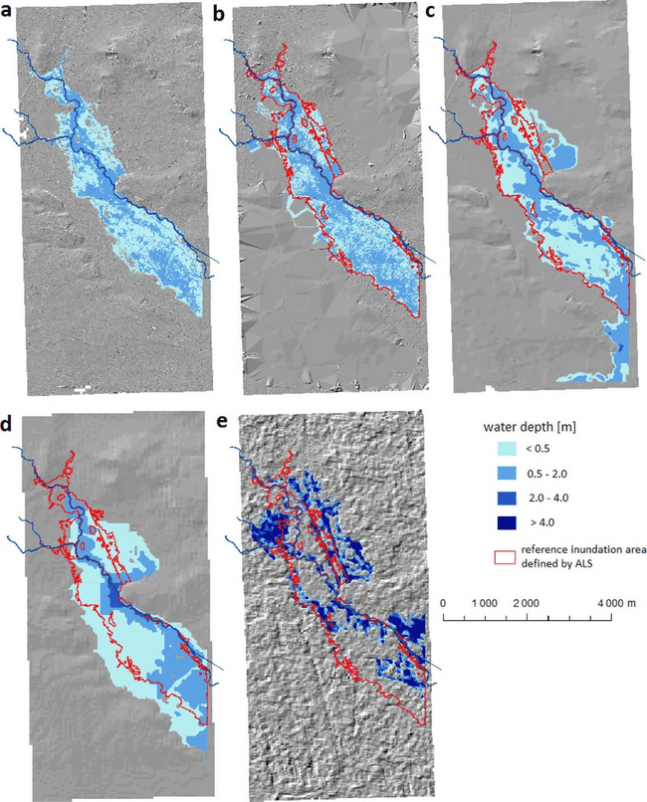
Hydrodynamic Models(2D Hydraulic Models)
2D hydraulic modeling is a sophisticated computational approach used in hydraulic engineering and hydrology to simulate the behavior of water in two dimensions.
Considering both the horizontal and vertical dimensions of the study area.
It provides a comprehensive understanding of how water flows across landscapes, river systems, floodplains, and coastal regions.

Slide 12
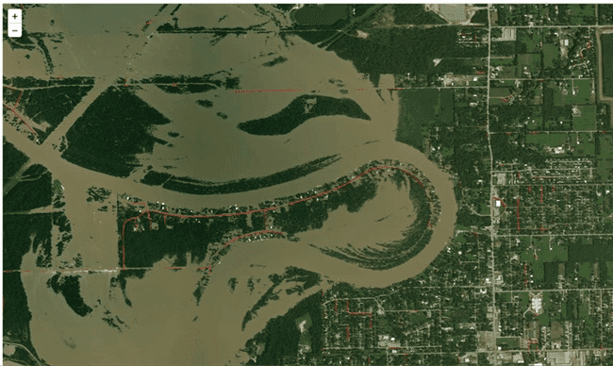
Remote Sensing and Satellite Imagery
It provide a unique perspective by capturing data from a distance, often from space-based platforms, and offer valuable insights into flood events.
When integrated with other data sources and technologies, they enhance our ability to understand, mitigate, and respond to the complex challenges posed by floods.

Slide 13
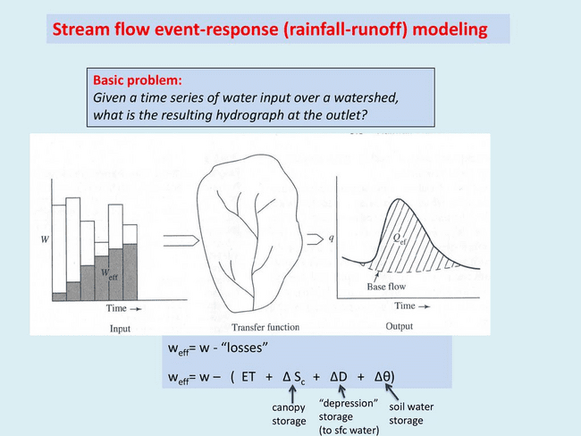
Rainfall-Runoff Models
Rainfall-runoff modeling is an area of study that uses mathematical equations to incorporate the characteristics of a watershed and its stream channels to predict the response of the watershed to storm events.
This model estimate the amount of runoff generated by rainfall in a watershed and how it contributes to river flow.
Coupled with river stage forecasts, they can predict flood extents.
These are calibrated and validated using observed streamflow data to ensure their accuracy in replicating real-world hydrological processes.

Slide 14
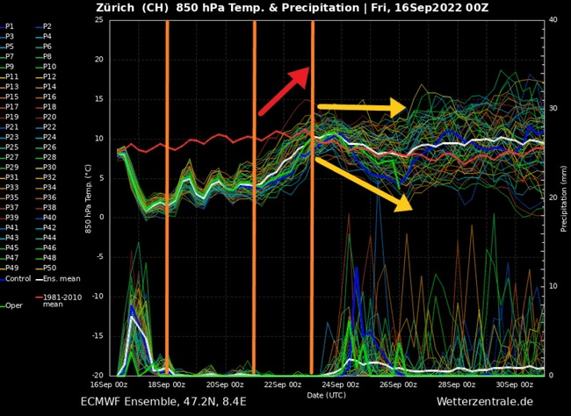
Ensemble Forecasting
Ensemble Forecasting brings together a variety of hydrological models, meteorological data sources, and scenarios.
This model may have different configurations, parameterizations, and input data, allowing for a broad exploration of possible outcomes.
Instead of relying on a single deterministic prediction, Ensemble Forecasting adopts a probabilistic approach. It generates a range of possible inundation scenarios, each with its associated likelihood or probability.
This reflects the uncertainty in forecasting and provides a more comprehensive understanding of flood risk.

Slide 15
Our proposal
This problem can be solved using CNN algorithm by creating a Deep Learning Hydro Informatics(DLHI).
DLHI leverages deep learning model, such as Convolutional Neural Networks (CNNs) and Recurrent Neural Networks(RNN), to create an entirely data-driven flood inundation mapping system.
Convolutional Neural Network, is a type of artificial neural network primarily used for processing and analyzing visual data, such as images and videos.

Slide 16
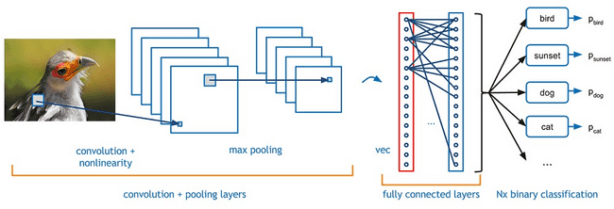
Sample CNN model
They are designed to automatically and adaptively learn patterns and features from input data, making them well-suited for tasks where the spatial arrangement of data is crucial.
CNNs have been highly successful in various computer vision tasks, including image classification, object detection, facial recognition, and more.

Slide 17
Advantages
Some of the advantages are:-
* Spatial Understanding
* High Spatial Resolution
* Real-time Processing
* Automation

Slide 18
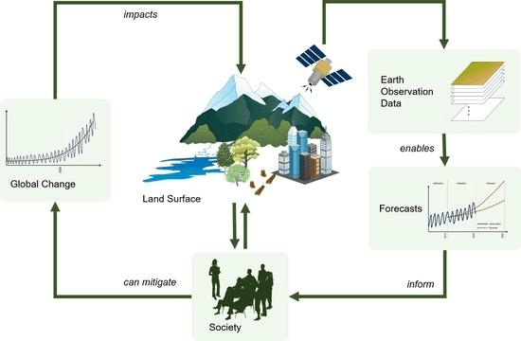
Architecture

Slide 19
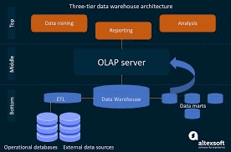
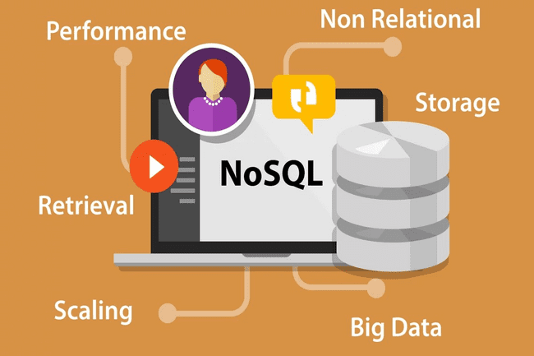
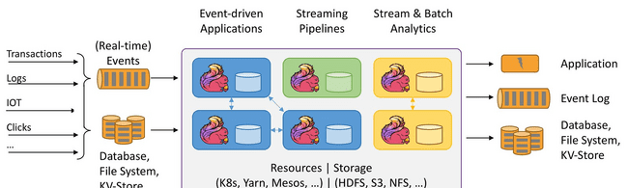
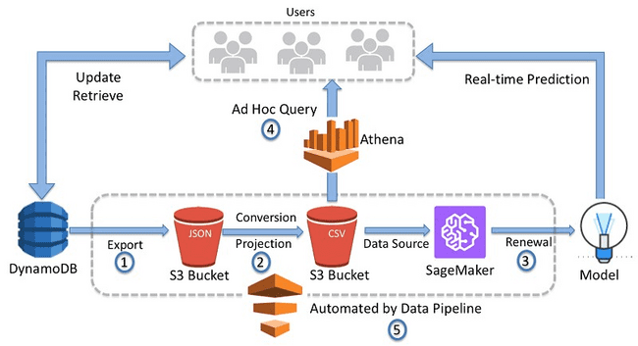
Data Storage and Management and Data Ingestion and Processing
Relational Databases
NoSQL Databases
Data Warehousing
Data Ingestion Pipeline
Stream Processing
Batch Processing

Slide 20

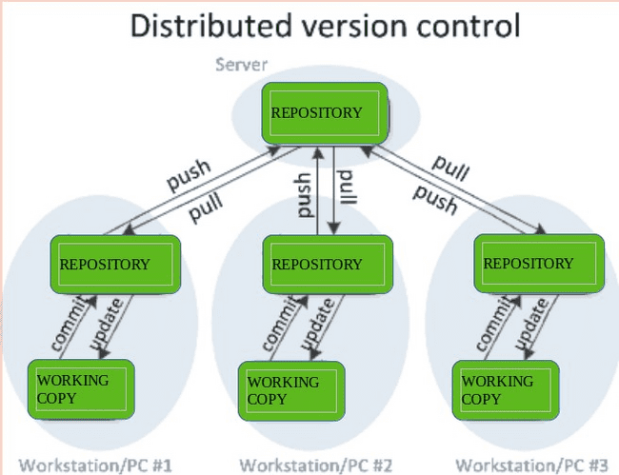
Deep Learning Infrastructure and Scalable Computing Resources
GPU Servers: using GPU-equipped servers or cloud instances for training and inference using deep learning models.
Frameworks: Utilizing deep learning frameworks such as TensorFlow for model development and training.
Model Version Control: Implementing a version control system (e.g., Git) for tracking changes to model.
Cloud Computing: Leveraging cloud platforms (e.g., AWS, Google Cloud, Microsoft Azure) to dynamically scale resources based on demand.

Slide 21
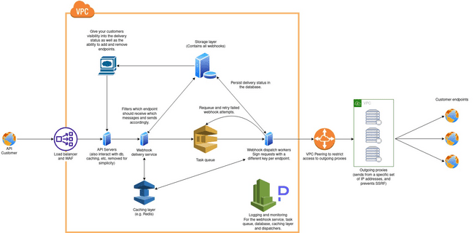
Real-time Data Integration, Web Application Development
APIs and Webhooks: Set up API endpoints and webhooks to receive real-time data from river gauges, weather APIs, and social media platforms.
Front-end Development: Building user interfaces for web using technologies like React, Angular, or Vue.js.
Back-end Development: Develop the application's back end using a programming language and framework suitable for the project (e.g., Node.js, Django, Ruby on Rails).

Slide 22

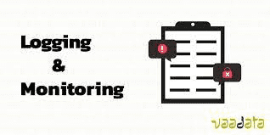
Data Security and Privacy , Monitoring and Logging
Encryption: Implementing encryption mechanisms (e.g., HTTPS, SSL/TLS) to secure data transmission and storage.
Access Control: Setting up role-based access control (RBAC) to manage who can access and modify data and system components.
Logging Framework: Implement a robust logging system to capture system events, errors, and user activities.
Monitoring Tools: Using monitoring tools like Prometheus, Grafana, or Datadog to track system performance and resource utilization.
Alerting: Configure alerting systems to notify administrators of critical issues or anomalies.

Slide 23
Deployment and Continuous Integration , Documentation, Backup and Disaster Recovery
CI Pipeline: Setting up automated CI pipelines to facilitate code integration, testing, and deployment.
Container Orchestration: Deploying containerized applications using Kubernetes or a similar orchestration platform
Documentation: Creating comprehensive documentation for system architecture, data sources, APIs, and usage guidelines.
Regular Backups: Implement automated backup procedures to ensure data integrity and availability.

Slide 24
Technology stack
Frameworks:
TensorFlow
Py Torch
Geospatial Technologies
Geographic Information Systems (GIS)
Machine Learning and Deep Learning Libraries
Libraries like scikit -learn, Keras , and OpenCV
Cloud Computing Services:
Amazon Web Services (AWS),
Microsoft Azure,
Google Cloud Platform (GCP)
Blockchain

Slide 25
Conclusion
This flood inundation projection project employing CNN models and Deep Learning Hydro informatics methodologies represents a significant step forward in flood risk reduction and management.
It combines technological innovation with community engagement and ethical considerations, ultimately contributing to more resilient and prepared communities in the face of flooding events.

